Slide 1
Name: Kayode Emeka Oladele
Course/Module: BAN6420 Final Project
21st May 2025.

Slide 2

Income and Spending Analytics for Healthcare Product Launch Data Collection & Visualization Tool

Slide 3
Project Overview
Purpose To build a survey web app to collect user demographic and financial data, analyze their spending habits, and guide product targeting decisions in the healthcare sector.
Scope
Web application built with Flask
Data stored in MongoDB
Data exported to CSV for analysis
Visualized insights in Jupyter Notebook
Deployed app to AWS for access and scalability

Slide 4
Survey Data Structure
Collected Fields
Name
Age
Gender
Income
Expenses (Utilities, Entertainment, School Fees, Shopping, Healthcare)
Data Pipeline Web Form → MongoDB → Python Class → CSV → Jupyter Notebook

Slide 5

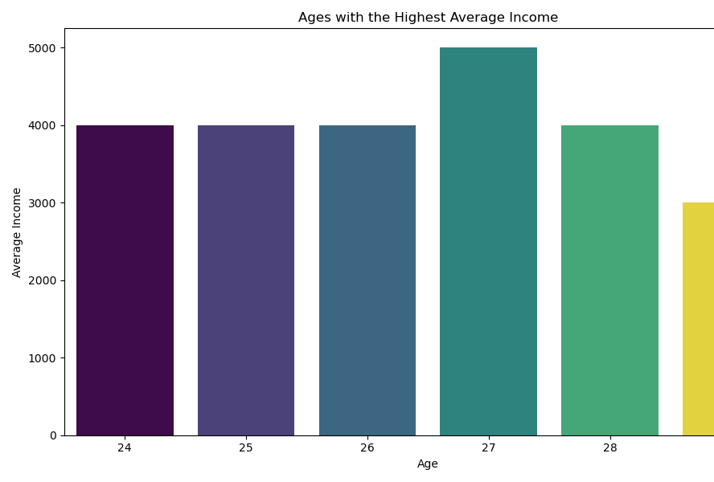
Top Earning Age Groups
Insight Summary
Individuals aged 27 had the highest average income.
Ages 24–28 overall show strong earning capacity.
This age group may be ideal for early-stage product targeting.

Slide 6
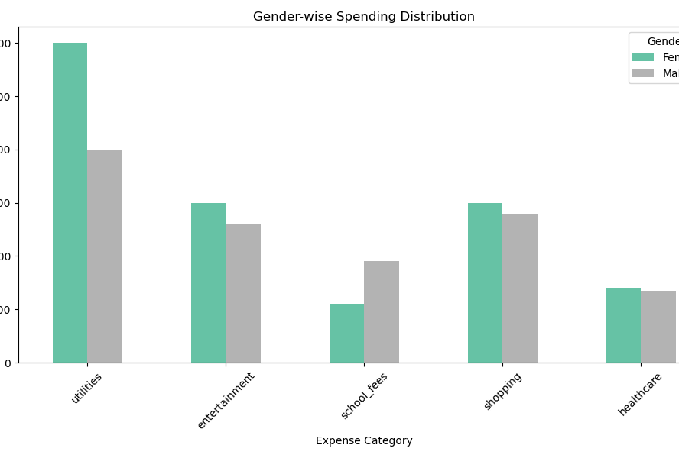
Gender-wise Spending Distribution
Insight Summary
Females spent significantly more on utilities and entertainment.
Males showed higher spending on school fees.
Overall, spending patterns vary by gender, which can inform targeted messaging.

Slide 7

Key Insights
Age 27 is the top earning demographic.
Utilities and shopping are top expense categories.
Females dominate in utility and entertainment spending.
Males spend more on school fees.

Slide 8
Application Deployment
Platform: Amazon Web Services (AWS)
Hosted the Flask survey app on AWS EC2 instance
MongoDB connected and configured
App is live and capable of handling real-time submissions
Benefits
Scalable and accessible
Real-time data capture
Ready for internal pilot or A/B testing

Slide 9


Next Steps & Recommendations
Deploy app in a controlled pilot phase with test users
Expand survey to more demographics
Use findings to tailor healthcare product messaging
Integrate dashboard for real-time analytics

